Slide 1
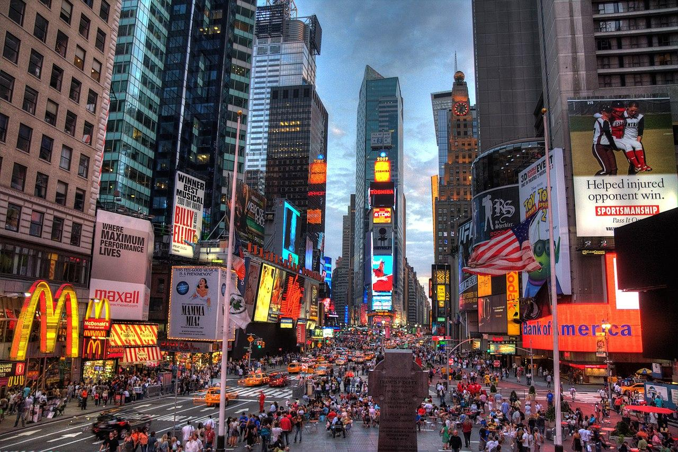


EPPS 6356
Climate Change and Crime
Contributor
Americo Gamarra
Contributor
Brennan Stout
Contributor
Changho Lee
Contributor
Umme Kulsum

Slide 2
Introduction
Agenda
Literature Review
Methodology
Data
Analysis
Conclusion??
01
02
03
04
05
06
EPPS 6356

Slide 3
Introduction: Umme Kulsum
Order of Presenting
Literature Review: Umme Kulsum
Methodology : Umme and Changho
Data: Americo Gamarra
Analysis: Changho Lee
Conclusion: Brennan
01
02
03
04
05
06
EPPS 6356

Slide 4





Introduction
EPPS 6356
Some researchers have found correlations or likelihood in violent crime with high ambient temperatures (Trujillo & Howley 2021; Hsiang et al, 2013)
Robert Agnew (2011) suggested that changing climate will facilitate social conflict and will help increase crime opportunities. According to him, climate change will be one of the major driving forces in the upcoming years

Slide 5
Objective
EPPS 6356
Explore the relationship between climate change and crime rate.
Compare the relationship between climate change and crime for different climatic conditions.

Slide 6
Literature Review
EPPS 6356
02

Slide 7
i. Crime Forecast Due to Climate Change
EPPS 6356
Ranson (2014) forecasted that between 2010-2099, there will be an additional of 22, 000 murders and 1.2 million aggravated assaults because of climate change. Mares et al, (2019) suggests that for 1°C increase in the temperature, on an average the number of crimes will increase by 100,000 annually.

Slide 8
ii. Seasonality in Crime
EPPS 6356
Monthly temperature anomalies for warmer months are linked to higher number of homicides. In case of other crimes e.g., rape, the relationship is stronger with colder months.

Slide 9
iii. Climate Change - Temperature - Crime Hypothesis (CC-T-C)
EPPS 6356
Lynch et al, (2020) used the term in their article which refers to the concept that temperature and level of crime will increase which has been stressed by the green criminologists.

Slide 10
iv. Geographical Scope
EPPS 6356
The scale of the studies also varies. Some researchers looked into this at a larger scale and others at a local scale.

Slide 11
Methodology
EPPS 6356
03

Slide 12
i. Exploratory Data Analysis
EPPS 6356
Aggregating data to check for relationships provide conflicting results
Creating charts to explore the data visually is time consuming as the data contains 468 months and each month has multiple entries for each crime type

Slide 13
i. Exploratory Data Analysis
EPPS 6356
Decade | Average Temperature | Average Crime per 1000 | Average Population | State
1980 | 46.29 | 122.05 | 288447 | New York
1990 | 47.06 | 67.68 | 297794 | New York
2000 | 47.30 | 69.23 | 308805 | New York
2010 | 48.00 | 63.92 | 321834 | New York
2020 | 49.04 | 30.35 | 319370 | New York
1980 | 64.47 | 5.75 | 65299 | Texas
1990 | 65.25 | 5.56 | 73896 | Texas
2000 | 65.69 | 5.84 | 89551 | Texas
2010 | 66.21 | 4.10 | 106705 | Texas
2020 | 66.85 | 2.25 | 117450 | Texas

Slide 14
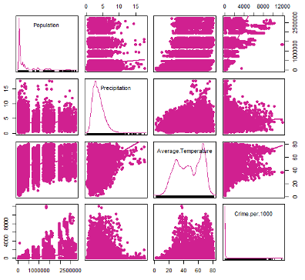
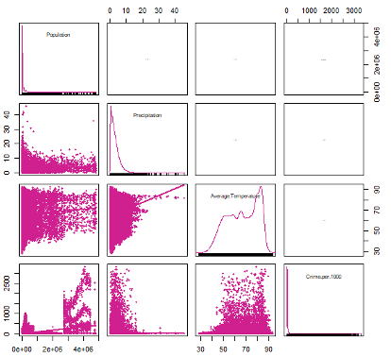
i. Exploratory Data Analysis
EPPS 6356

Slide 15
ii. Bayesian modeling approach using INLA
EPPS 6356
Enhanced Predictive Modeling
Leverages spatial and temporal autocorrelation to estimate missing data, improve predictions, and provide robust decision-making under uncertainty.
Explicit Uncertainty Modeling
Bayesian approaches like INLA deliver credible intervals for predictions and insights into result reliability, ensuring transparency in uncertainty quantification.
Versatile Applications Across Fields
Applicable to disease mapping, environmental monitoring, and social science research; INLA also manages high-dimensional data with latent variables, accommodating complex spatio-temporal challenges.

Slide 16
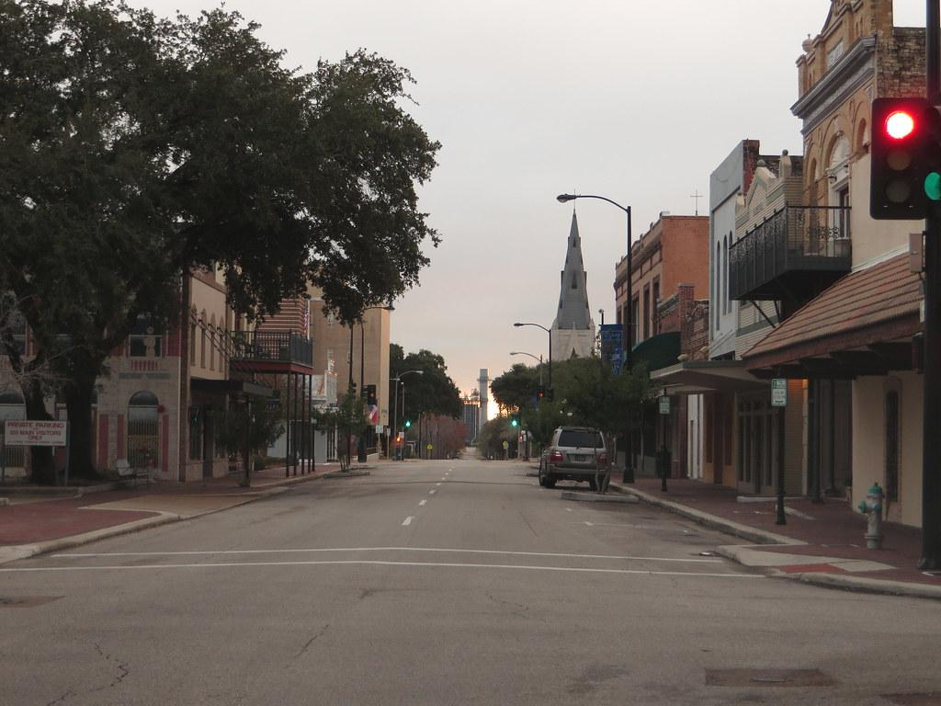


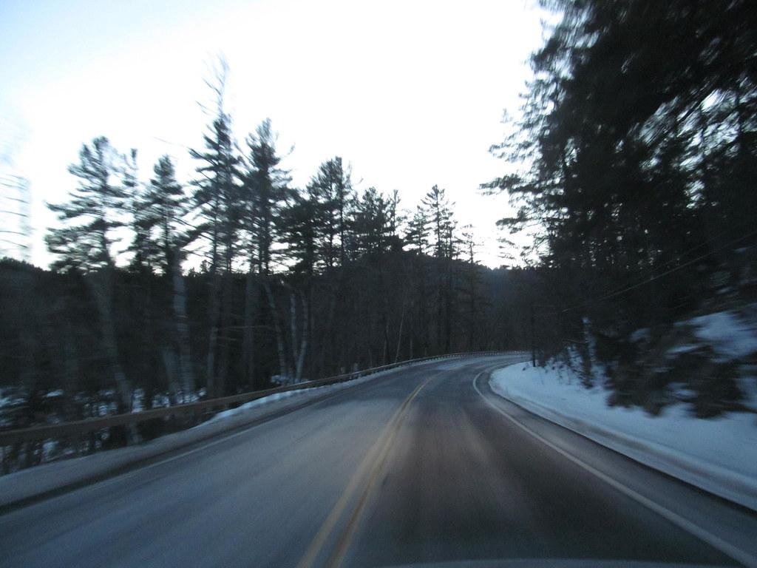


Texas vs. New York

Slide 17

Texas
EPPS 6356
Texas is the second largest in the United States of America by population and land area.
Texas has been divided into 10 climate zones according to the National Climatic Data Center

Slide 18
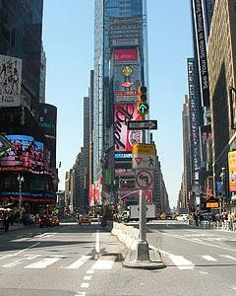
New York
EPPS 6356
New York was its leading state till 1960 in almost all the indices (e.g., population, economic and cultural) (Brittanica, Accessed: Dec 2024).

Slide 19
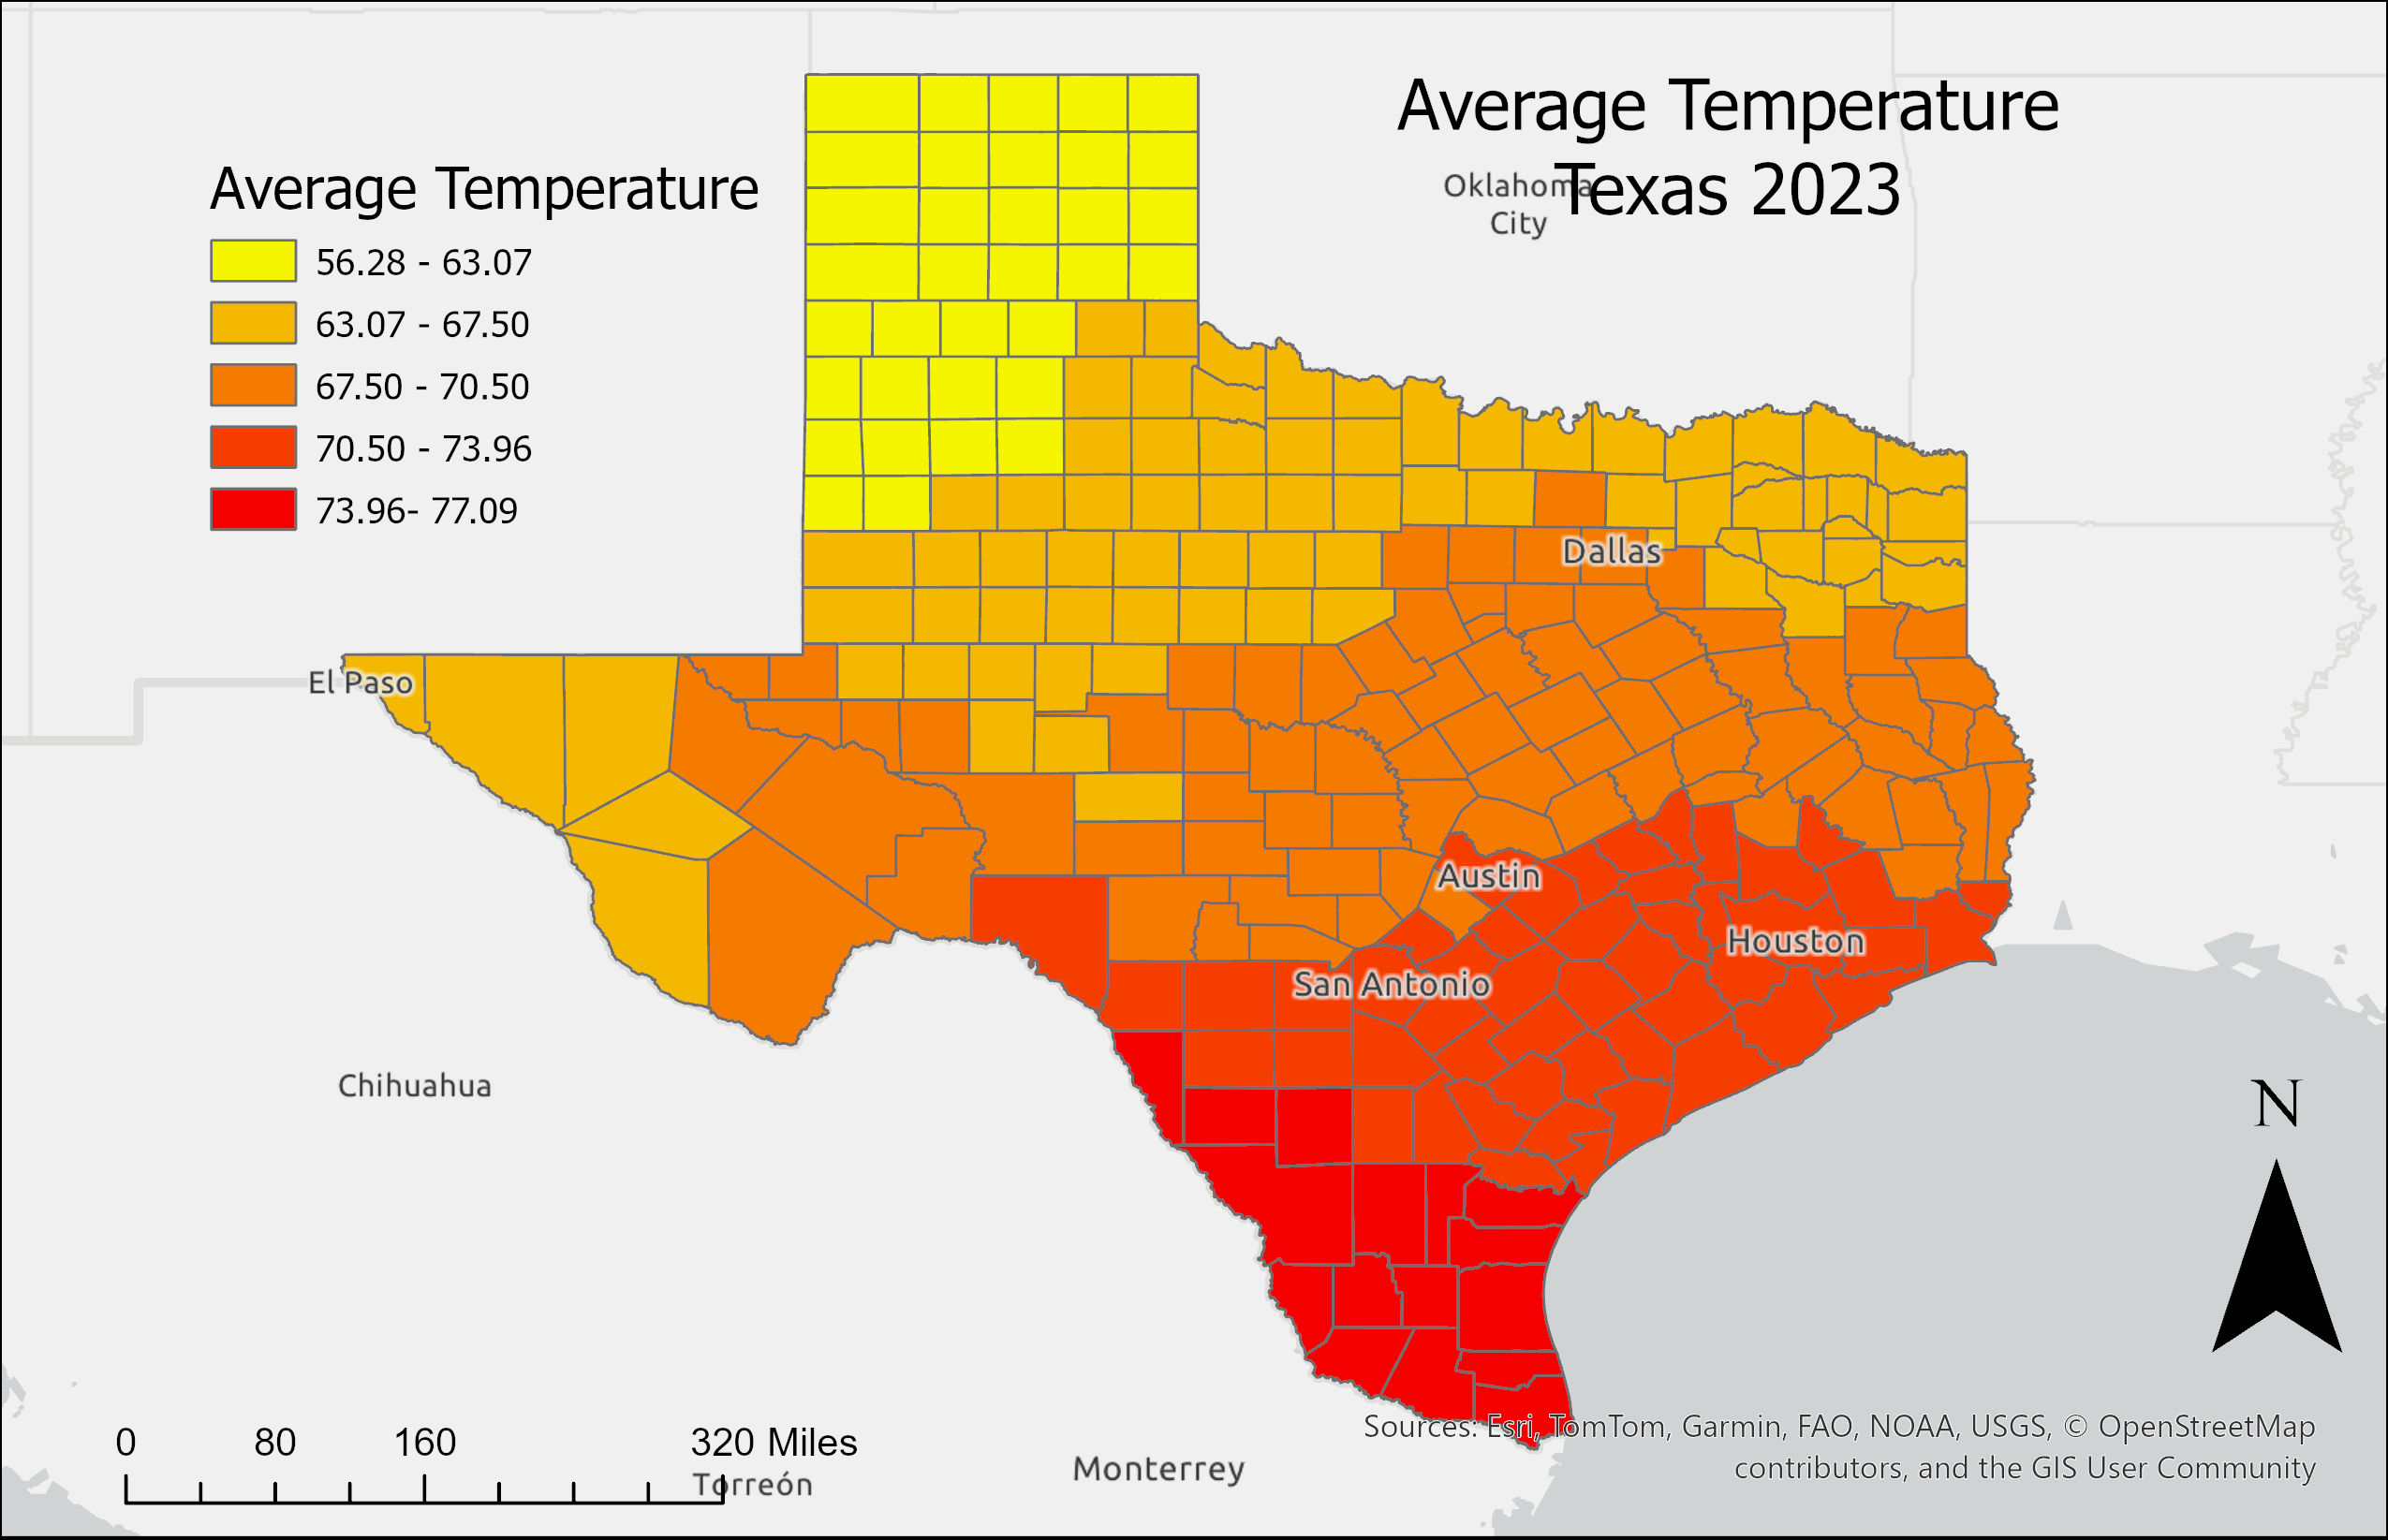
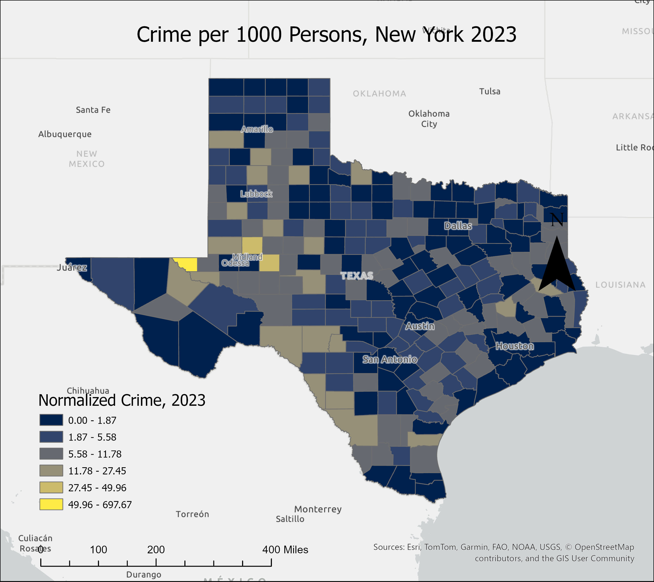
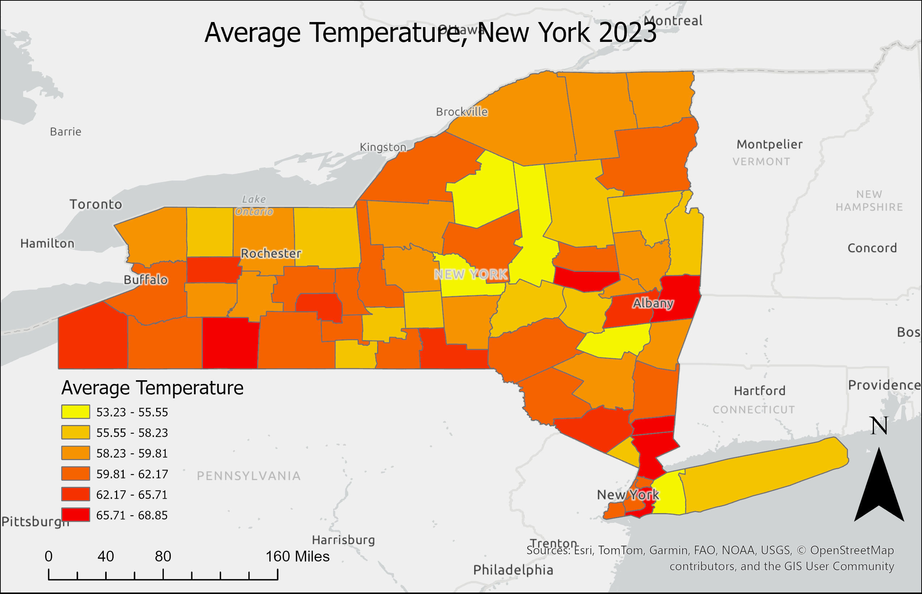
Methodology : Temperature

Slide 20
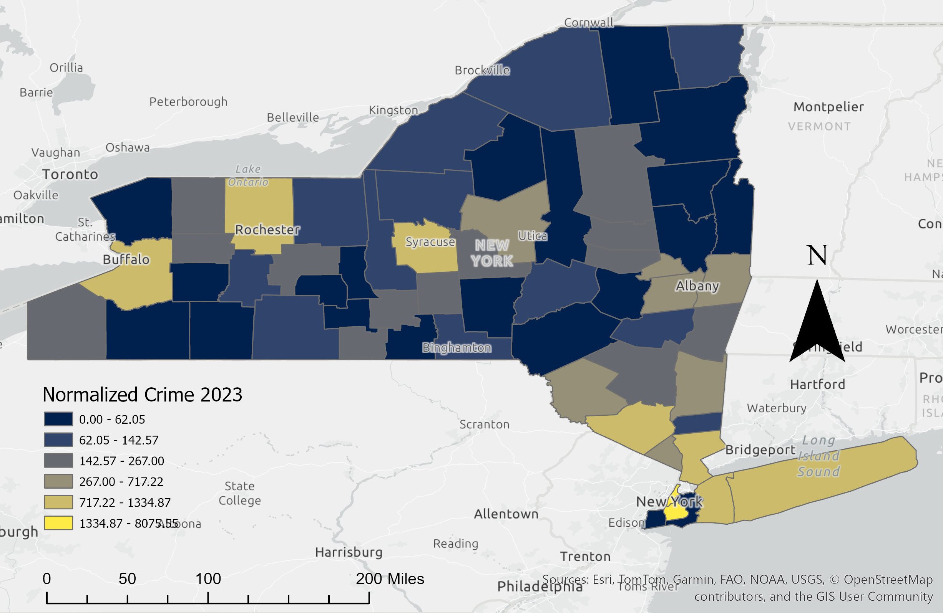
Methodology : Crime

Slide 21
Data
EPPS 6356
04

Slide 22
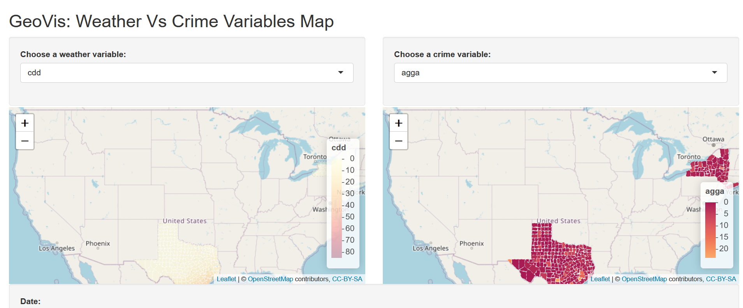
Data
EPPS 6356
04
Shiny Visualization

Slide 23



Source
Crime data for the Texas and New York 1985 – 2023
Crimes against person
Using the FBI UCR API
County or lower area
Climate data for the Texas and New York 1985 – 2023
Temperature
Humidity
Precipitation
County or lower geographical unit area
Socio-economic data for the Texas and New York 1985 – 2023
Unemployment rate
Annual population

Slide 24

Variables
Crime:
Crime type
Aggravated Assault
Robbery
Rape
Arson
Homicide
Burglary
Larceny
Motor Vehicle Theft
Date
Monthly
Locations
Texas and New York
Climate:
Atmosphere
Temperature
Average Temperature
Maximum Temperature
Minimum Temperature
Humidity
Precipitation
Date
Monthly
Population
Annual
Crimes Against Person (Violent Crime

Slide 25
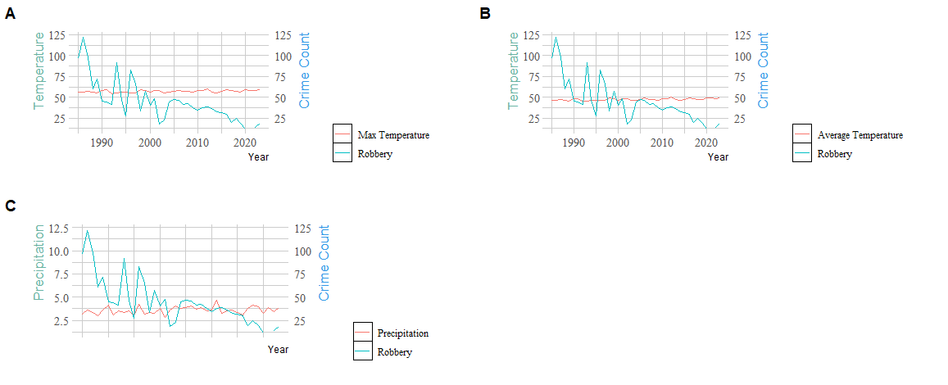
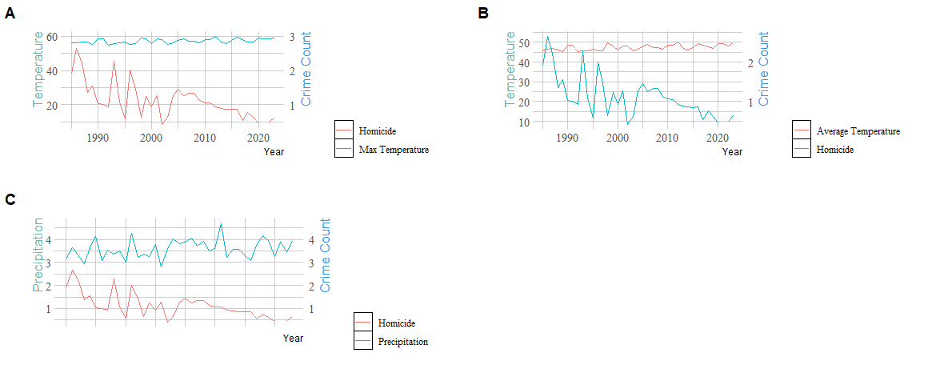
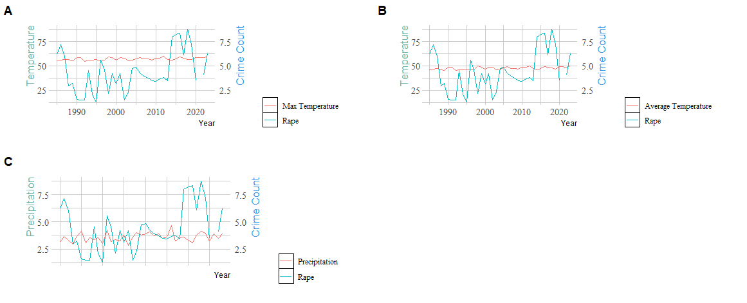
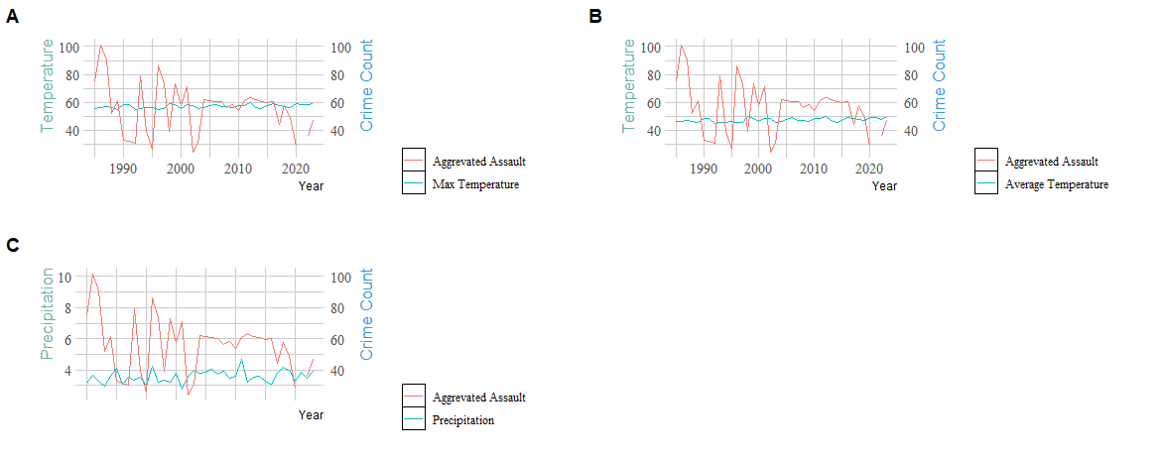
Data
EPPS 6356
Crime
Relation between climate and violent crime annually between the years 1985 and 2023 for New York
Robbery
Homicide
Rape
Aggravated Assault

Slide 26
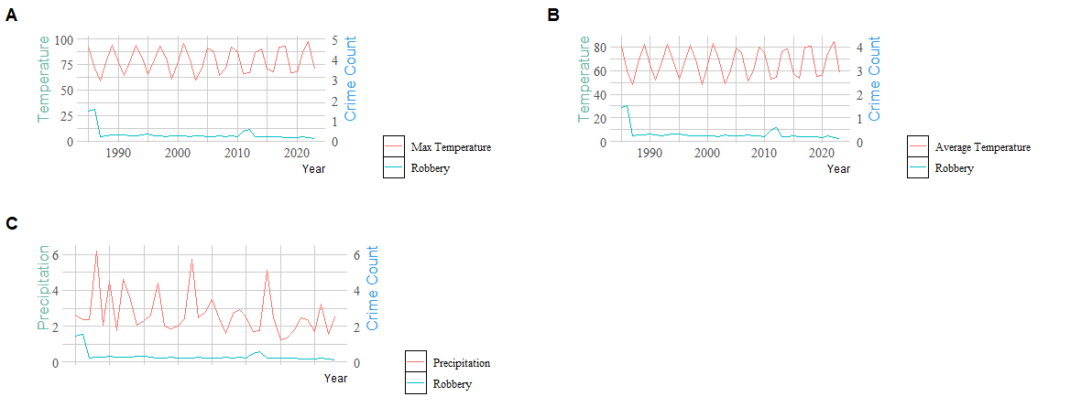
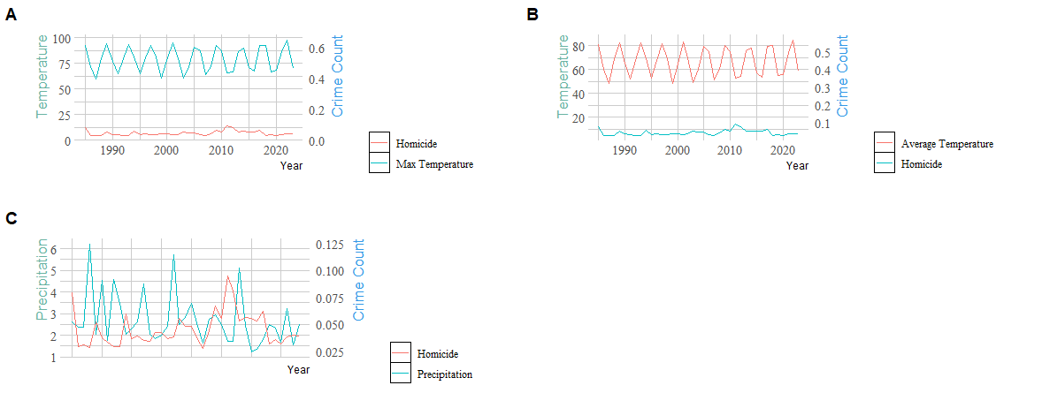
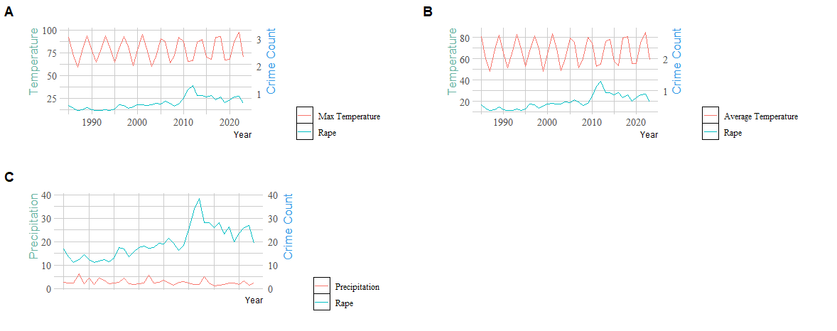
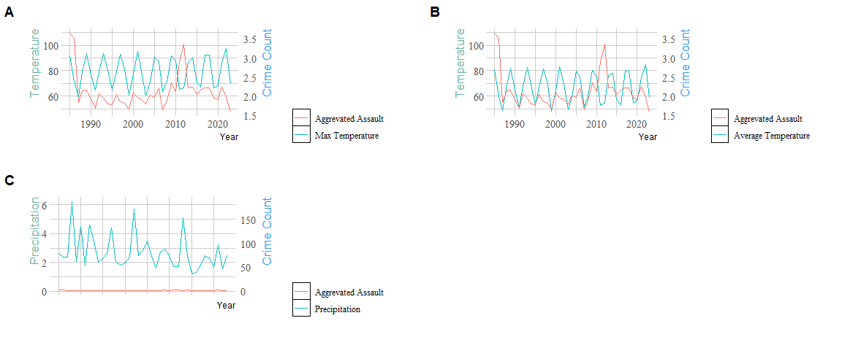
Data
EPPS 6356
Crime
Relation between climate and violent crime annually between the years 1985 and 2023 for Texas
Robbery
Homicide
Rape
Aggravated Assault

Slide 27
Data
EPPS 6356
Climate
Relation between climate and crime monthly between the years 1985 and 2023 for Texas and New York

Slide 28
Analysis
EPPS 6356
05

Slide 29
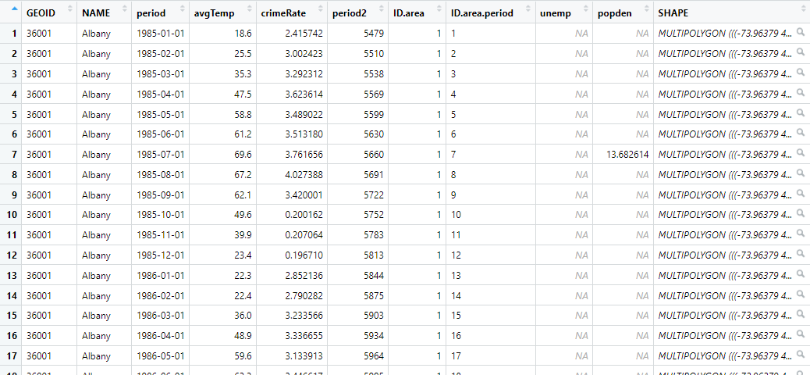
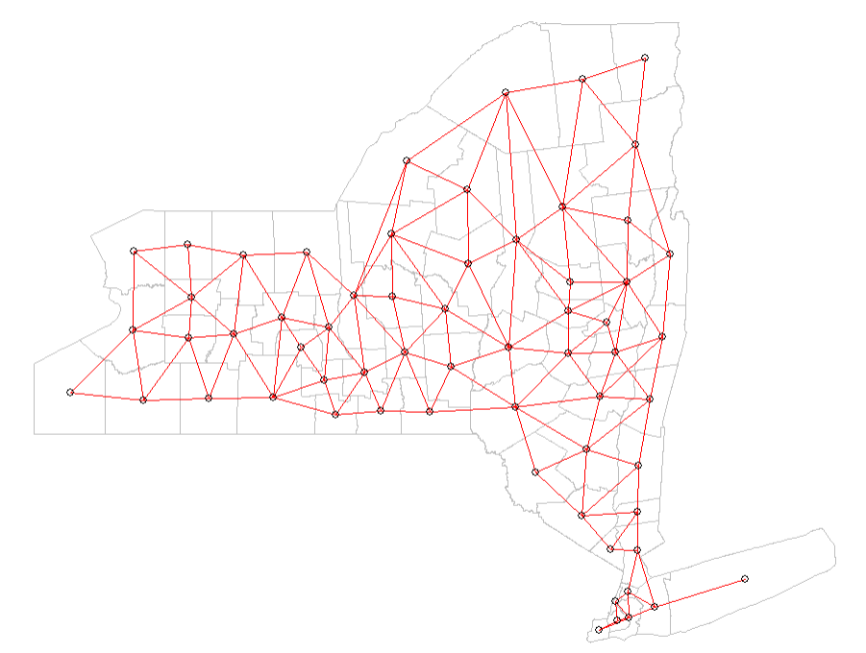
Model Construction
EPPS 6356
Dependent variable :
Crime rate (unit: events / 1,000 persons)
Independent variable :
Mean temperature
(unit: Fº )
Unemployment rate
(unit: % )
Population density
(unit: % )
Spatial component :
Adjacent matrix
(method: queen )
Temporal component :
Autoregressive
(order: 1 for TX and 2 for TX)

Slide 30
Model Result (TX)
EPPS 6356
Model for crime rate (events / 1,000 ppl) log-transformed (crime rate + 0.0001) | Model 1: Null | Model 2: Climate | Model3: Climate + Economic | Model 4: Climate + Economic + Demographic
Intercept | -3.226 (0.582) | -3.721 (0.507) | -3.833 (0.676) | -3.700 (0.325)
Average Temperature |  | 0.007 (0.001) | 0.007 (0.001) | 0.007 (0.001)
Unemployment rate(%) |  |  | 0.028 (0.004) | 0.028 (0.004)
Population Density(ppl/sq.km) |  |  |  | -0.003 (0.001)
Residuals | 0.139 (0.001) | 0.139 (0.001) | 0.139 (0.001) | 0.139 (0.001)
Spatial random effect (neighbor:queen) | 0.053 (0.006) | 0.055 (0.005) | 0.056 (0.005) | 0.057 (0.006)
Temporal random effect, ar(1) | 1.785 (0.660) | 2.253 (0.347) | 1.844 (0.694) | 4.826 (0.768)
Temporal autocorrelation, ar(1) | 0.994 (0.003) | 0.996 (0.001) | 0.997 (0.001) | 0.986 (0.004)
Marginal log-likelihood | -286865 | -286826 | -286817 | -286836
RMSE | 14.506 | 14.512 | 14.502 | 14.496

Slide 31
Model Result (NY)
EPPS 6356
Model for crime rate (events / 1,000 ppl) log-transformed (crime rate + 0.0001) | Model 1: Null | Model 2: Climate | Model3: Climate + Economic | Model 4: Climate + Economic + Demographic
Intercept | -0.745 (0.238) | -1.113 (0.312) | -1.164 (0.321) | -1.170 (0.321)
Average Temperature |  | 0.008 (0.004) | 0.008 (0.004) | 0.008 (0.004)
Unemployment rate(%) |  |  | 0.007 (0.011) | 0.009 (0.011)
Population Density(ppl/sq.km) |  |  |  | 0.000 (0.000)
Residuals | 0.305 (0.003) | 0.305 (0.003) | 0.305 (0.003) | 0.305 (0.003)
Spatial random effect (neighbor:queen) | 0.533 (0.104) | 0.538 (0.106) | 0.532 (0.099) | 0.536 (0.105)
Temporal random effect, ar(1) | 0.406 (0.061) | 0.400 (0.059) | 0.399 (0.059) | 0.398 (0.061)
Temporal autocorrelation, ar(1) | 0.825 (0.027) | 0.824 (0.026) | 0.825 (0.026) | 0.825 (0.027)
Marginal log-likelihood | -59261 | -59268 | -59276 | -59280
RMSE | 6.023 | 6.021 | 6.021 | 6.016

Slide 32
Conclusions
EPPS 6356
05
Questions?

Slide 33
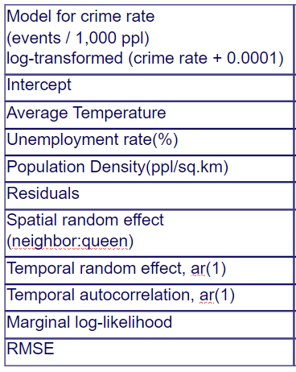
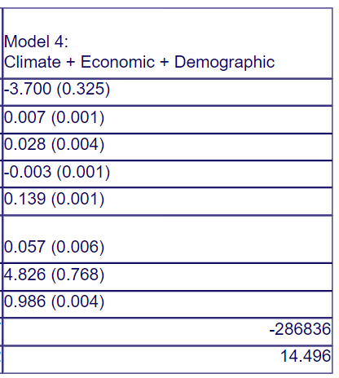
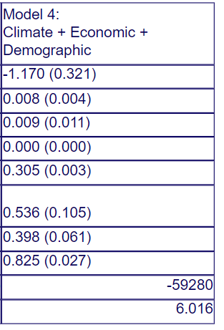
Model Result (TX vs NY)
EPPS 6356
Texas New York
Climate
Socio
Econ
Slight positive relationship between temperature and total crime rate, when normalized for population. Texas is more clear in this measure (lower SD, 0.001) than New York (0.004).

Slide 34
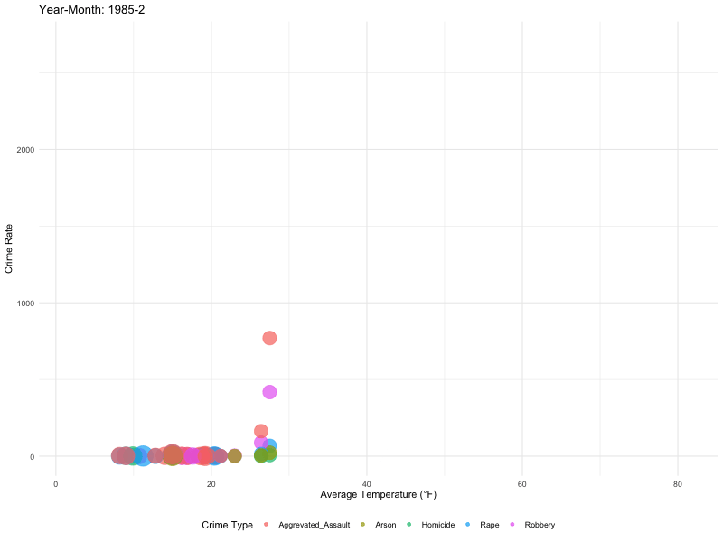
Conclusions
EPPS 6356
05
Questions?

Slide 35
References
Ranson, M. (2014). Crime, weather, and climate change. Journal of Environmental Economics and Management, 67(3), 274-302. https://doi.org/10.1016/j.jeem.2013.11.008
Trujillo, J. C., & Howley, P. (2021). The effect of weather on crime in a torrid urban zone. Environment and Behavior, 53(1), 60-89. https://doi.org/10.1177/0013916519845121

Slide 36
References
Hsiang, S. M., Burke, M., & Miguel, E. (2013). Quantifying the influence of climate on human conflict. Science, 341(6151), 1235367. https://doi.org/10.1126/science.1235367
Gamble, J. L., & Hess, J. J. (2012). Temperature and Violent Crime in Dallas, Texas: relationships and implications of climate change. The western journal of emergency medicine, 13(3), 239–246. https://doi.org/10.5811/westjem.2012.3.11746

Slide 37
References
Agnew, R.. (2012). Dire forecast: A theoretical model of the impact of climate change on crime. Theoretical Criminology, 16(1), 21–42. https://doi.org/10.1177/1362480611416843
Mares, D. M., & Moffett, K. W. (2019). Climate Change and Crime Revisited: An Exploration of Monthly Temperature Anomalies and UCR Crime Data. Environment and Behavior, 51(5), 502-529. https://doi.org/10.1177/0013916518781197

Slide 38
References
Lynch, M. J., Stretesky, P. B., Long, M. A., & Barrett, K. L. (2022). The Climate Change-Temperature-Crime Hypothesis: Evidence from a Sample of 15 Large US Cities, 2002 to 2015. International Journal of Offender Therapy and Comparative Criminology, 66(4), 430-450. https://doi.org/10.1177/0306624X20969934
Mares, D. (2013). Climate change and crime: Monthly temperature and precipitation anomalies and crime rates in St. Louis, MO, 1990–2009. Crime, Law and Social Change, 59(2), 185–208. https://doi.org/10.1007/s10611-013-9411-8

